Slide 1

Industrial Machine Learning on Hadoop and Spark
Maks Nakhodnov, Bremen 2025

Slide 2
Distributed computing. HDFS
Plan:
How to store big data?
Structure of the Linux filesystem.
Fault tolerance.
HDFS: its structure and main properties.

Slide 3


Slide 4
The "The Apache™ Hadoop™" project develops open-source software for fault-tolerant, scalable, and distributed computing.
Features:
Works with Big Data on standard servers
Strong open-source community
Many different products and tools use Hadoop

Slide 5
Started as a subproject in Apache Nutch – Nutch is an open-source web search engine – An open-source alternative to Google – Started by Doug Cutting
In 2004, Google published papers on GFS and MapReduce
Doug Cutting and the Nutch team implemented their framework based on these papers
In 2006, Yahoo! hired Doug Cutting to work on Hadoop in their team
In 2008, Hadoop became an Apache Top Level Project – http://hadoop.apache.org

Slide 6

Hadoop users

Slide 7
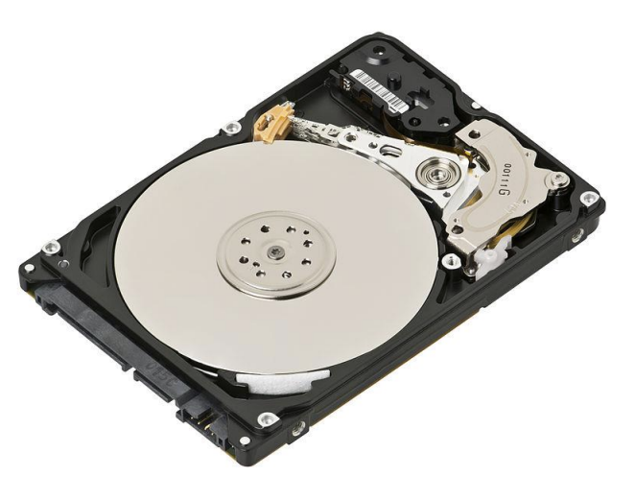
Data storage
Disk capacity has grown exponentially, unlike read speed:
— 1990
Capacity: 1,400 MB
Read speed: 4.5 MB/s
Reading the entire disk takes ~5 minutes
— 2010
Capacity: 1 TB
Read speed: 100 MB/s
Reading the entire disk takes ~3 hours
Hadoop
— 100 HDDs can simultaneously read 1 TB of data in 2 minutes

Slide 8
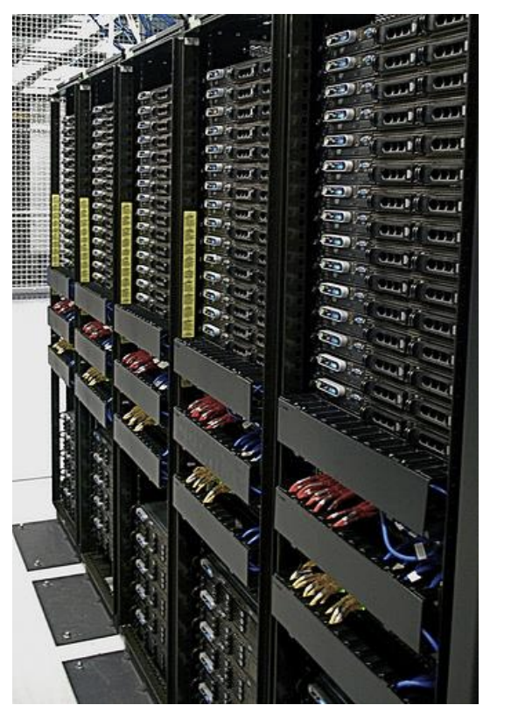
Hadoop Cluster
“Cheap” standard hardware: – Not supercomputers – Not desktops
Connected via a network
Located in one place: – Servers in racks within a data center

Slide 9
Hadoop System Principles
Horizontal (Scale-Out) scaling instead of vertical (Scale-Up)
Move code to the data
Handle node failures and hardware faults
Encapsulate the complexity of distributed and multithreaded applications

Slide 10
Scaling
Vertical scaling: – Add additional resources to existing hardware (CPU, RAM) – If hardware cannot be upgraded, buy a more powerful new one – Moore’s Law can’t keep up with data growth
Horizontal scaling: – Add more machines to the existing cluster – Applications support adding/removing servers – Easy to scale “down” as well

Slide 11
Data to code
Processing node
Data uploading
Storage node
Save the result
Processing node
Data uploading
Storage node
Save the result
Risk of a “bottleneck”

Slide 12
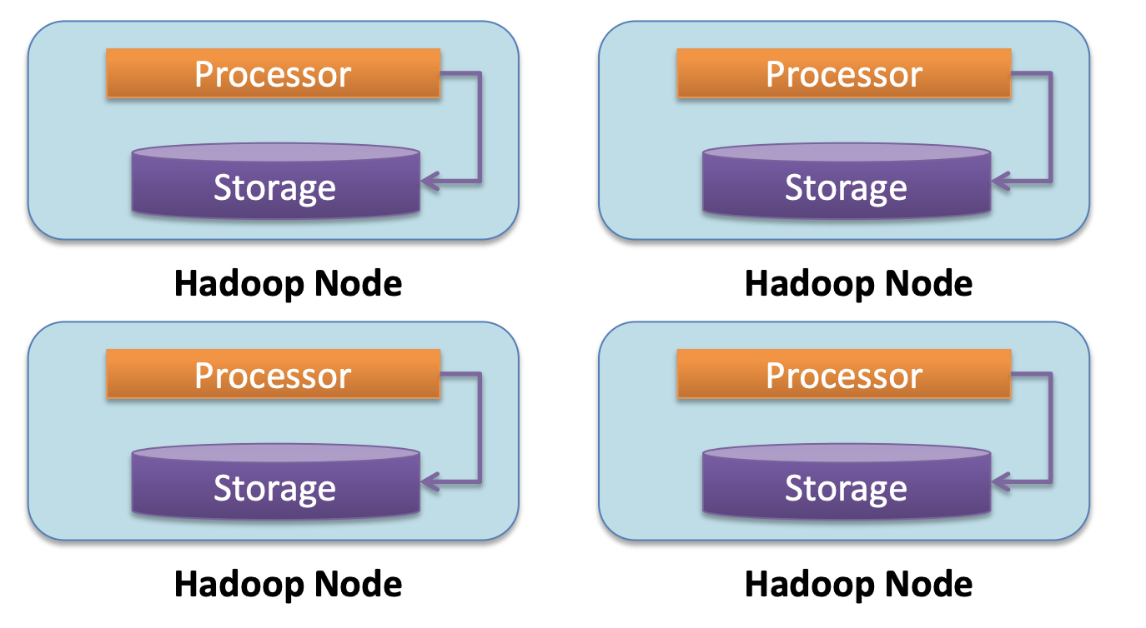
Code to data
Hadoop cluster

Slide 13
Hardware Failures
The more machines, the more frequent hardware failures will occur
Hadoop is designed with hardware failures in mind: – Data replication – Task restart

Slide 14
Encapsulation of Implementation Complexity
Hadoop hides many complexities of distributed and multithreaded systems
Frees developers from worrying about system-level issues: – Race conditions, data waiting – Organizing data transfer, data distribution, code delivery, etc.
Allows developers to focus on application development and implementing business logic

Slide 15
Hadoop Ecosystem
Main Hadoop components: – HDFS: Hadoop Distributed FileSystem – MapReduce: Framework for distributed data processing
Other components: – HBase: Column-oriented DB, supports sequential and random reads, and simple queries – Zookeeper: Highly-available coordination service – Oozie: Workflow scheduler for Hadoop – Pig: Data processing language and runtime – Hive: Data warehouse with a SQL interface

Slide 16
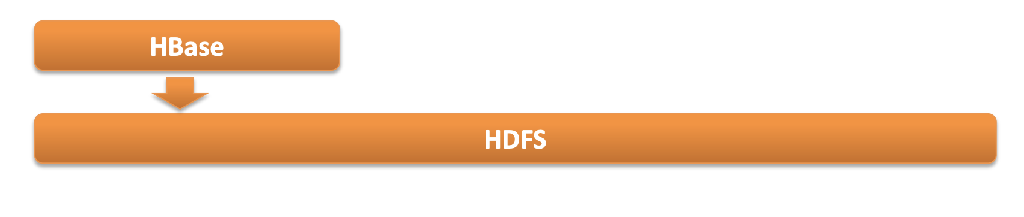
Hadoop Ecosystem
To develop an application, a filesystem is needed: – In Linux: ext3 and ext4 – In the Hadoop world: usually Hadoop Distributed File System (HDFS)
A convenient interface for working with data is also needed: – a Relational DBMS on top of the local filesystem – HBase: key/value store implemented on top of HDFS

Slide 17
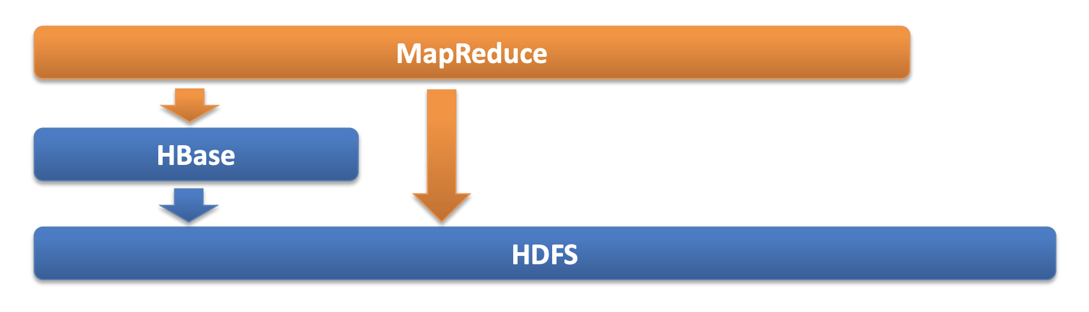
Hadoop Ecosystem
Framework for running MapReduce tasks

Slide 18
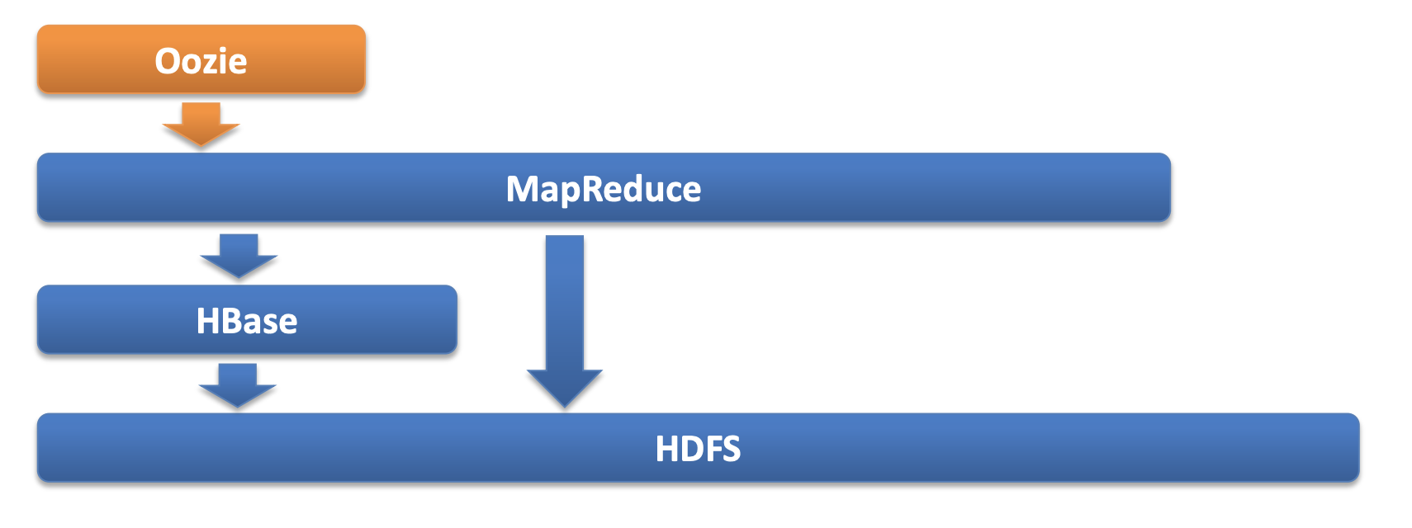
Hadoop Ecosystem
Apache Oozie: a popular tool for coordinating workflows of MapReduce tasks

Slide 19
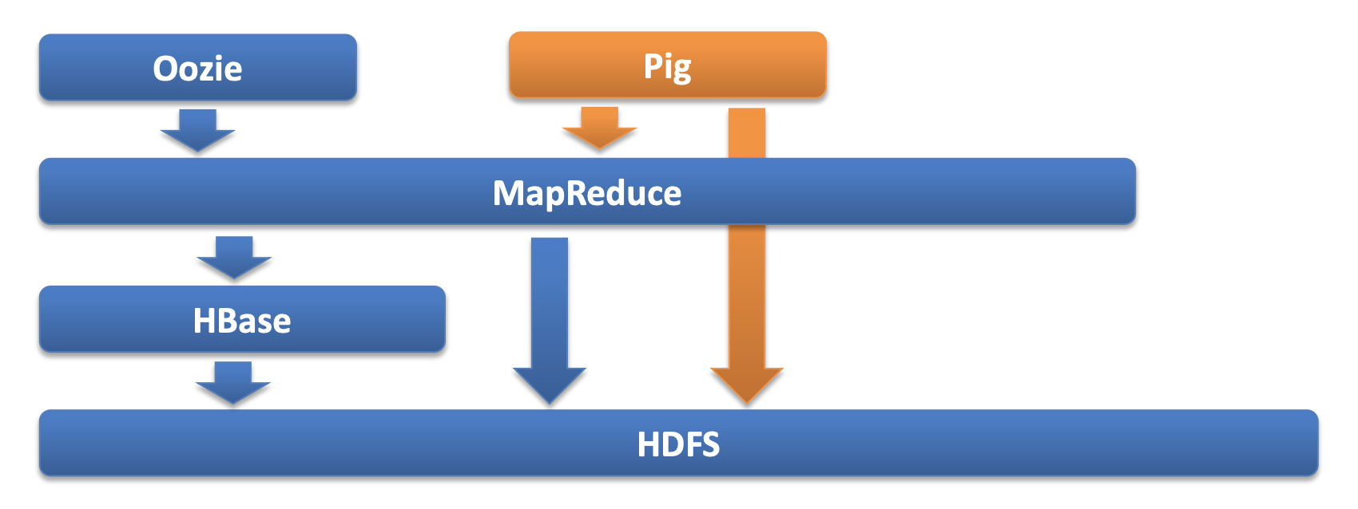
Hadoop Ecosystem
Apache Pig: a tool for data processing using high-level commands

Slide 20
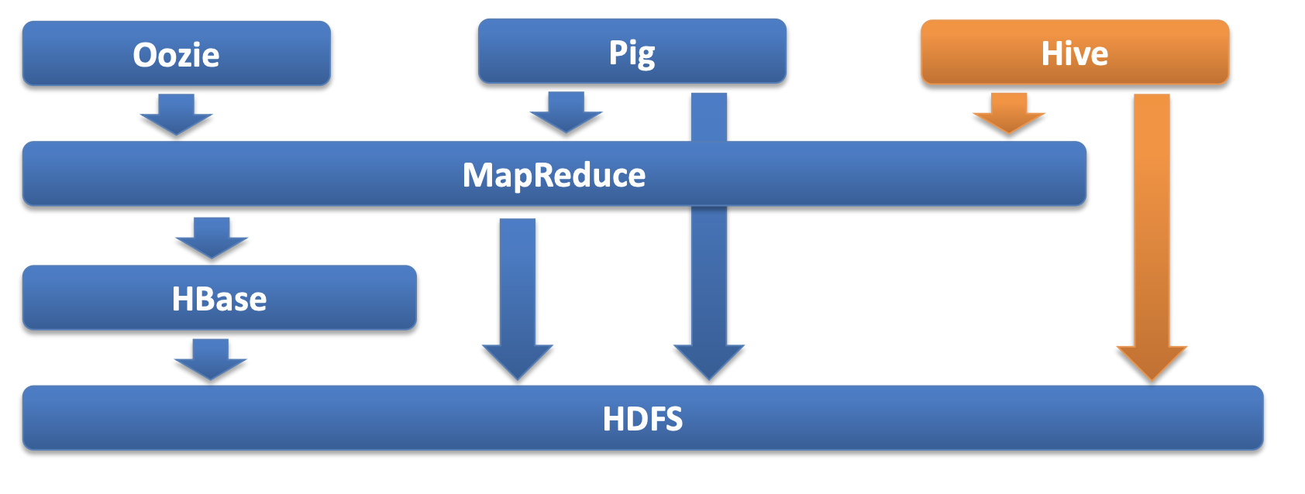
Hadoop Ecosystem
Apache Hive: data processing using SQL-like queries

Slide 21
Hadoop installation
Quite difficult to install from scratch. Using distributives is highly advised:
Cloudera Distribution for Hadoop (CDH)
MapR Distribution
Hortonworks Data Platform (HDP)
Apache BigTop Distribution
Greenplum HD Data Computing Appliance

Slide 22
Resources
Apache Hadoop Documentation – http://hadoop.apache.org
Each individual product has its own documentation
Each Hadoop vendor provides its own documentation – https://ccp.cloudera.com/display/DOC/Documentation

Slide 23




Hadoop: The Definitive Guide Tom White (Author) O'Reilly Media; 3rd Edition
MapReduce Design Patterns Donald Miner, Adam Shook (Authors) O'Reilly Media
Designing Data-Intensive Applications: The Big Ideas Behind Reliable, Scalable, and Maintainable Systems. Martin Kleppmann
HBase: The Definitive Guide Lars George (Author) O'Reilly Media; 1 edition

Slide 24
HDFS: its architecture and key properties

Slide 25
Google's Filesystem GFS research.google.com/archive/gfs-sosp2003.pdf

Slide 26
Main tasks of HDFS
Fault tolerance in conditions of frequent failures and breakdowns
Parallel processing of data segments

Slide 27
Goals:
Hardware failure is more the norm than the exception.
Applications running on HDFS deal with large datasets. A typical HDFS file ranges from gigabytes to terabytes.
Write once, read many (WORM)
"Moving computation is cheaper than moving data" (Data locality)
HDFS is designed to be easily portable across different platforms.

Slide 28
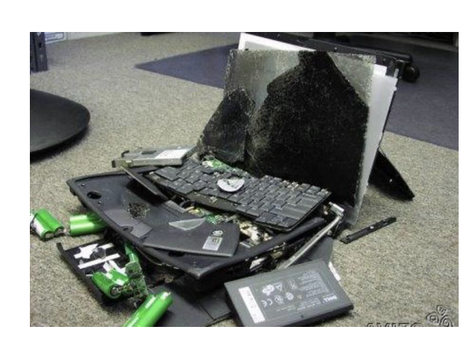
Main Principles: Fault Tolerant
Runs on a server cluster
Appears to the user as “one large disk”
Operates on top of standard filesystems (Ext3, Ext4, XFS)
Data is not lost if disks or servers fail

Slide 29
Main Principles: Uses standard “hardware”
“Cheap” server equipment:
Not supercomputers!
Not desktops!
Yes, ordinary (unreliable) servers!

Slide 30
Main Principles: HDFS is good for…
Storing large files
Terabytes, petabytes…
Millions (but not billions) of files
Files sized from 100 MB and up
Data streaming
“Write once / read-many times” pattern
Optimized for sequential reading: no random read operations
Standard servers
Less reliable than supercomputers

Slide 31
Main Principles: HDFS is bad for…
Low-latency reads
High throughput rather than fast data access
HBase helps address this requirement
A large number of small files
Better to have a million large files than a billion tiny ones
For example, 1,000 files of 1 GB each is better than 100,000 files of 10 MB each
Multithreaded writing
Only one process can write to a file
Data is appended to the end of the file
No support for writing at a specific offset

Slide 32
Useful definitions
Cluster – a collection of computers connected by a network and performing tasks sent by clients. Node – one of the computers connected to the cluster. Rack – a group of several nodes connected by a network. Daemon – a program in UNIX-like systems that is started by the system and runs in the background without direct user interaction. Client – a hardware or software component of a computing system that sends requests to a server.

Slide 33
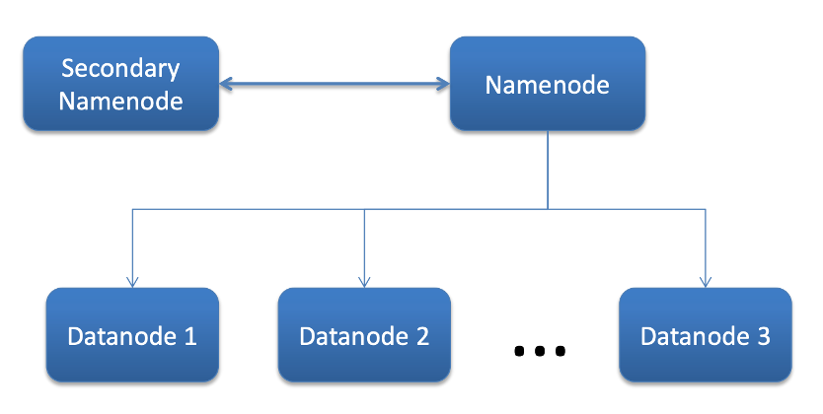
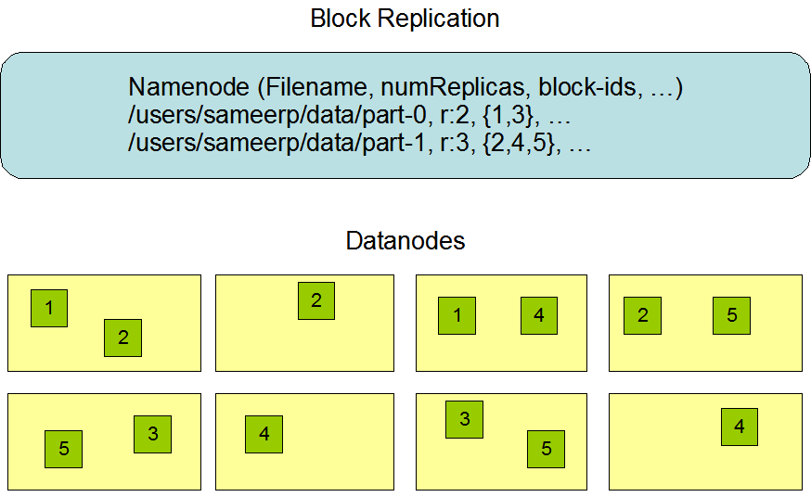
HDFS Daemons

Slide 34
NameNode
Responsible for:
File namespace
Metadata
File block locations
Runs on a single (dedicated) machine

Slide 35
NameNode
FSImage:
Snapshot of the entire HDFS filesystem at a point in time
Stored on the NameNode; contains metadata: files, directories, access permissions
Edit Logs:
Log of filesystem changes (adding, deleting, renaming files)
Applied to FSImage at NameNode startup to restore the current state
Under the hood:
At NameNode startup: FSImage + all Edit Logs → builds the current filesystem tree
Secondary NameNode / Checkpoint Node: periodically merges FSImage + Edit Logs → creates a new FSImage, reducing log size

Slide 36
DataNode
Stores and serves data blocks
Sends status reports to the NameNode
Runs on every machine in the cluster

Slide 37
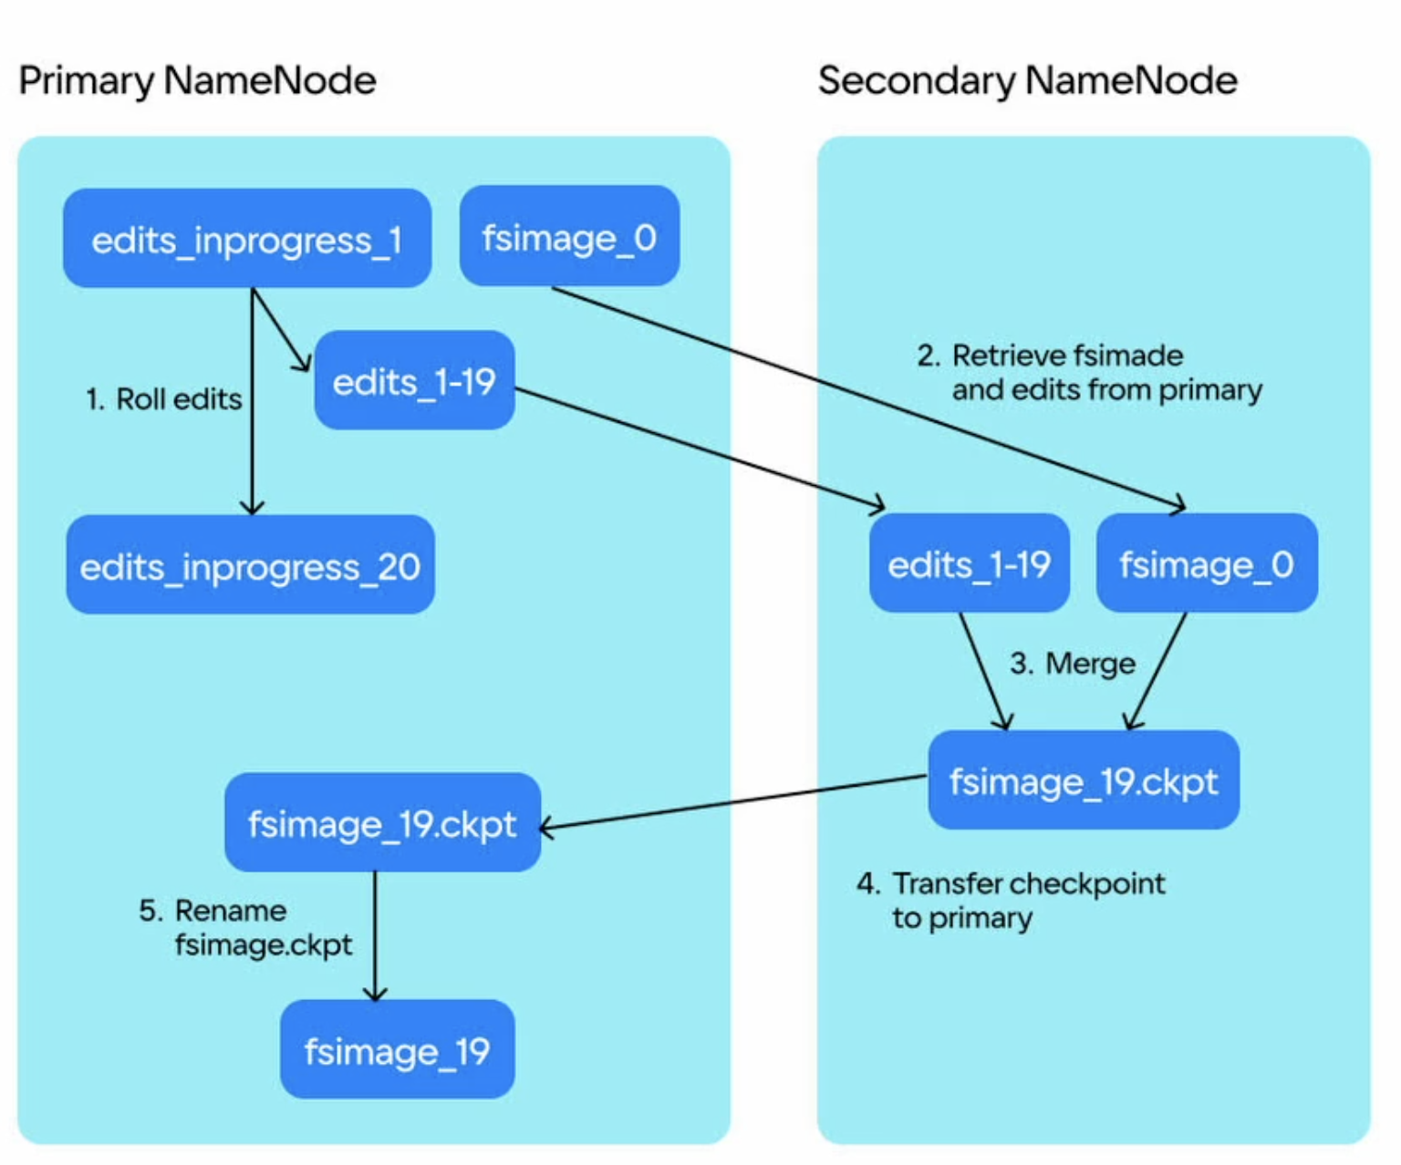
Secondary NameNode
Periodically updates the fsimage
Requires the same hardware as the NameNode
(!) Not used for high availability; i.e., it is not a backup for the NameNode

Slide 38
Files and blocks
Files in HDFS consist of blocks - A block is a unit of data storage
Managed by the NameNode
Stored on DataNodes
Blocks are replicated across machines during writing - The same block is stored on multiple DataNodes
- Default replication factor is 3
- Ensures fault tolerance and simplifies data access

Slide 39
HDFS Blocks
Standard block size: 64 MB or 128 MB
The main reason is to reduce the cost of seek time compared to data transfer speed: Time to transfer > Time to seek
Let
seek time = 10 ms
transfer rate = 100 MB/s
What should be the block size so that the seek time is only 1% of the transfer rate?

Slide 40
Placing & Replication
The NameNode determines where to place blocks
Balances reliability and performance – Attempts to reduce network load (bandwidth) – Attempts to improve reliability by placing replicas on different racks
Default replication factor is 3:
1st replica on the local machine
2nd replica on another machine in the same rack
3rd replica on a machine in a different rack

Slide 41
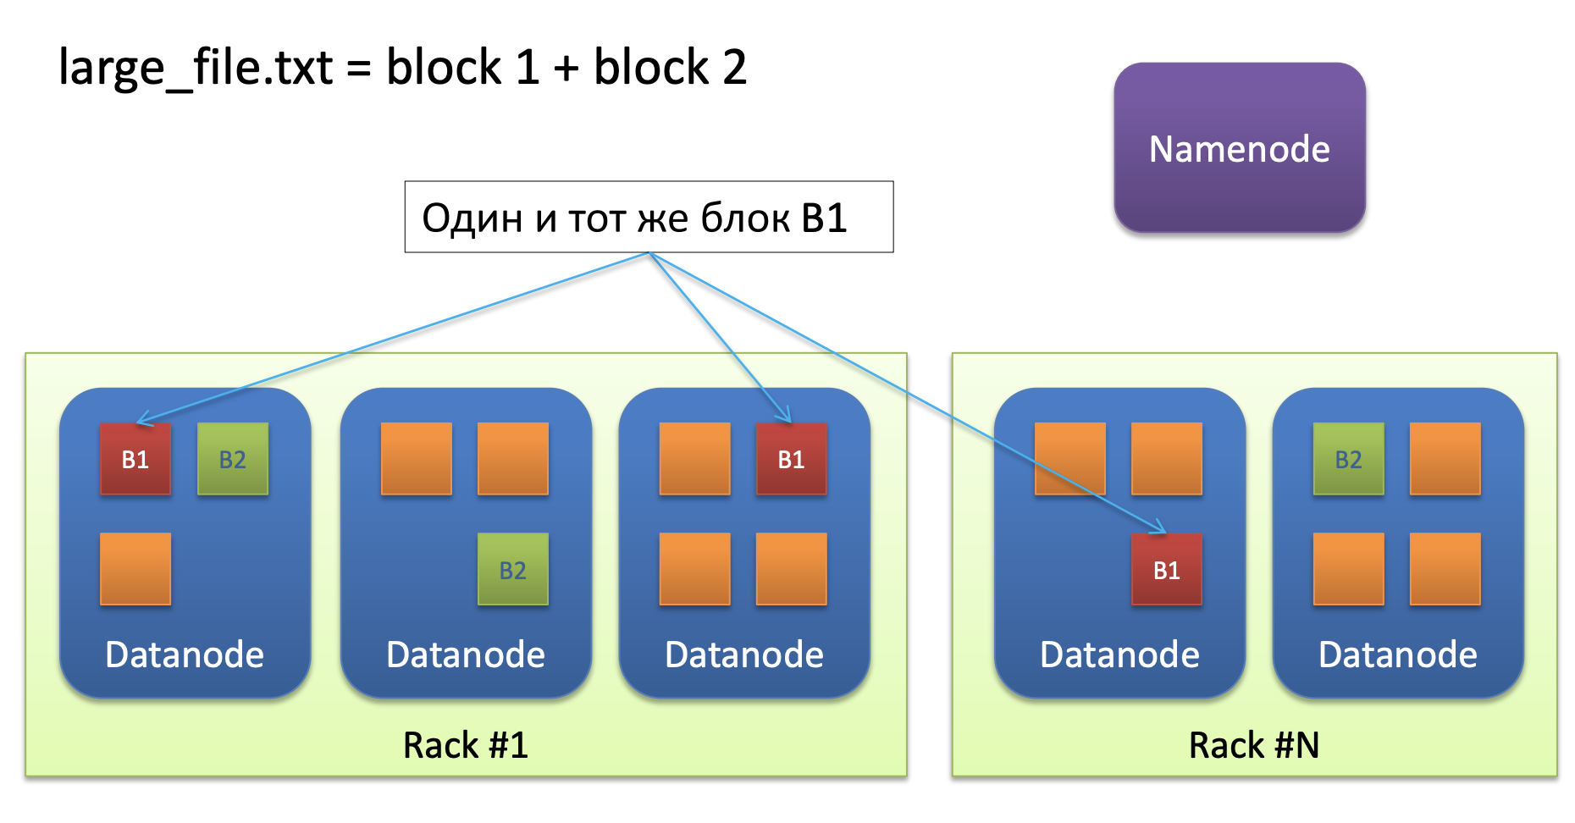
Replication
The same block B1

Slide 42
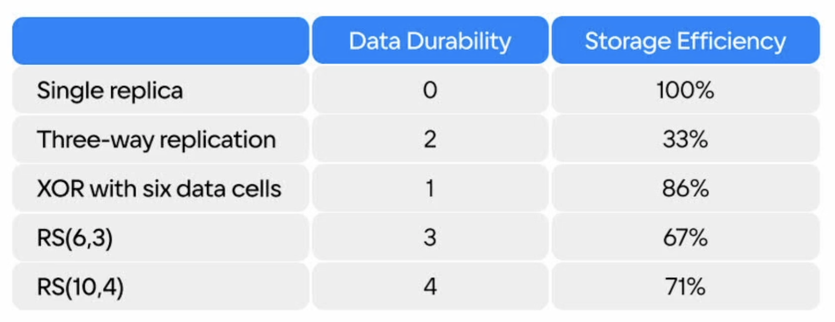
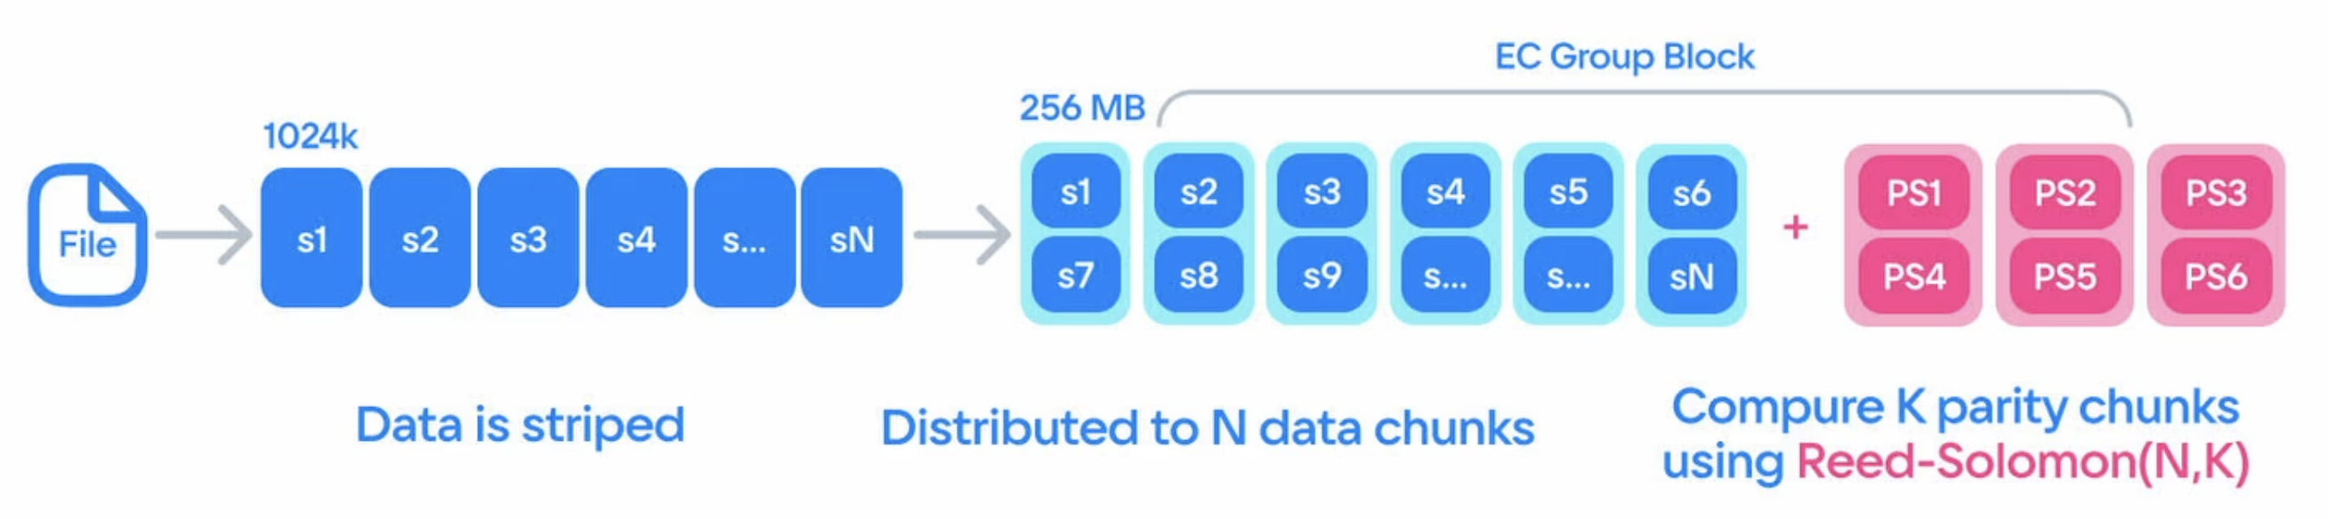
Replication. Erasure coding (EC)
Alternative to replication for data protection
Data is split into k data blocks + m parity blocks
Can recover data if up to m blocks are lost
Saves space compared to 3x replication
Suitable for cold storage of large data volumes
Example: 600MB file, block size 100MB
3x replication:
6 blocks × 3 = 18 blocks (1800 MB)
EC(6,3):
6 blocks + 3 parity = 9 blocks (900 MB); up to 3 blocks can be lost

Slide 43

Client-server interaction

Slide 44
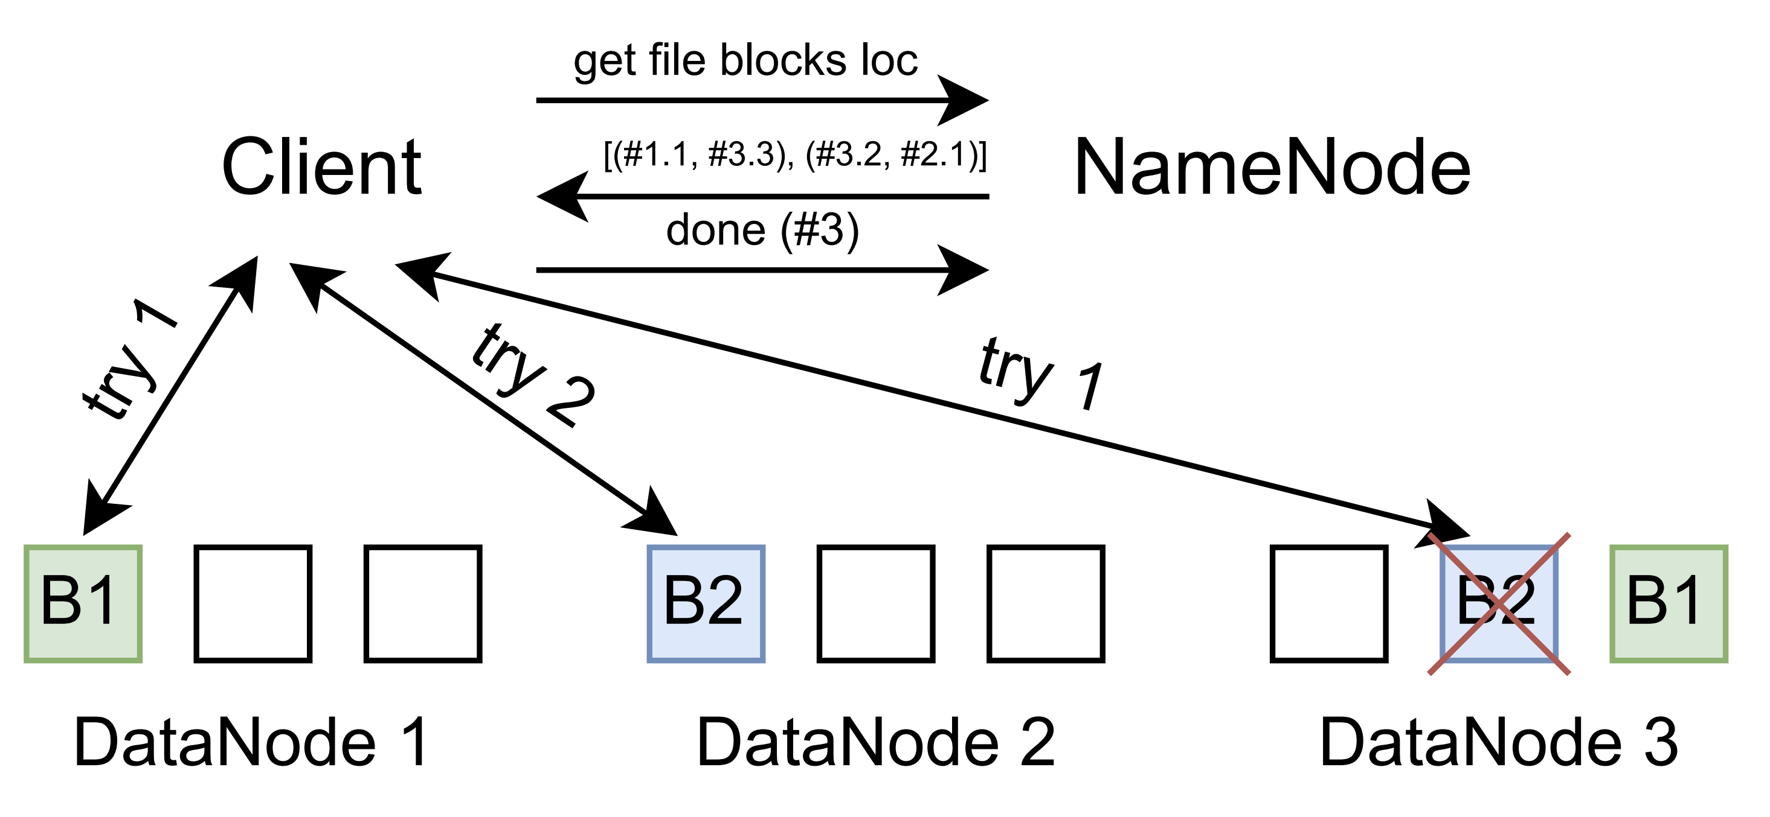
Client-server interaction. Read

Slide 45
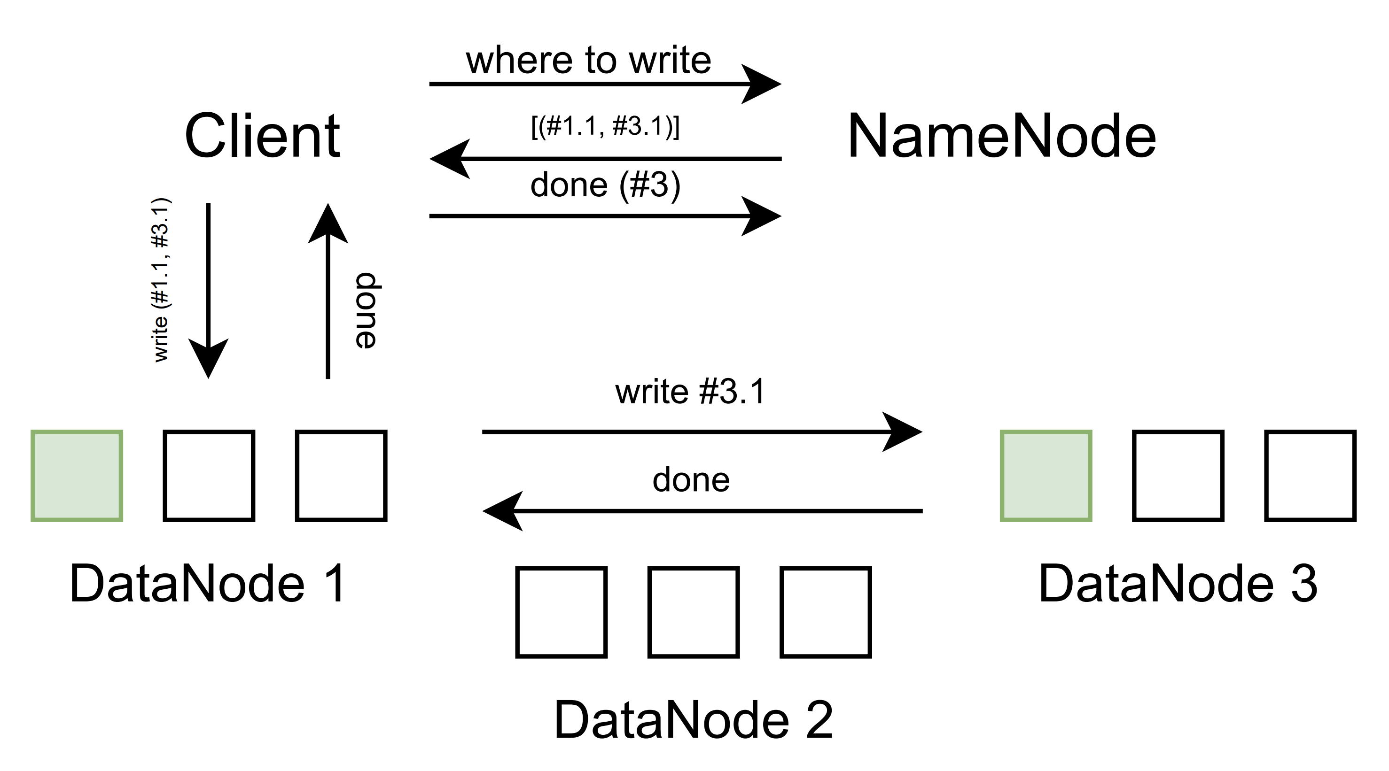
Client-server interaction. Write

Slide 46
NameNode: memory utilization
For fast access, all block metadata is stored in the NameNode’s RAM:
The larger the cluster, the more RAM is required
Better to have millions of large files than billions of small ones
Operates on clusters with hundreds of machines
NameNode Federation (Hadoop 2+):
Each NameNode manages a portion of the blocks
Horizontal scaling of NameNodes
Supports clusters with thousands of machines
Details: http://hadoop.apache.org/docs/r2.0.2-alpha/hadoop-yarn/hadoop-yarn-site/Federation.html

Slide 47
NameNode: memory utilization
How does block size affect the maximum filesystem size?
Larger block size → fewer blocks
Fewer blocks → more files in the filesystem
More blocks → more RAM (~1 GB heap for 1M blocks)
Let’s say we have 200 TB = 209,715,200 MB
With a block size of 64 MB: 209,715,200 MB / 64 MB = 3,276,800 blocks
With a block size of 128 MB: 209,715,200 MB / 128 MB = 1,638,400 blocks

Slide 48
NameNode: Fault tolerance
If the NameNode fails, HDFS does not work:
NameNode is a single point of failure
Should run on a separate, reliable machine
Usually, this is not a problem
High Availability NameNode (Hadoop 2+):
An Active-Standby process is always running and takes over management if the NameNode fails
More details here: http://hadoop.apache.org/docs/r2.0.2-alpha/hadoop-yarn/hadoop-yarn-site/HDFSHighAvailability.html

Slide 49
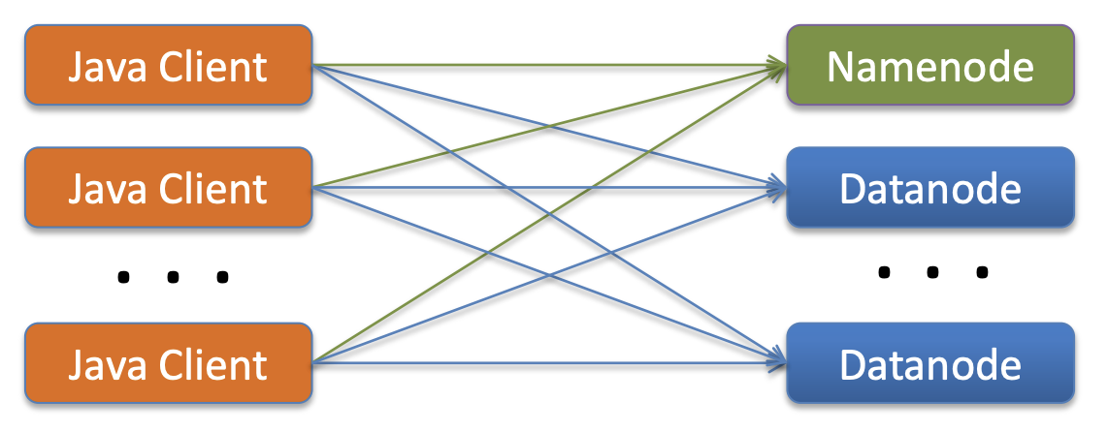
HDFS access — Direct access
API for Java and C++
Client requests metadata from the NameNode
Client directly requests data from the DataNode
Used for MapReduce

Slide 50
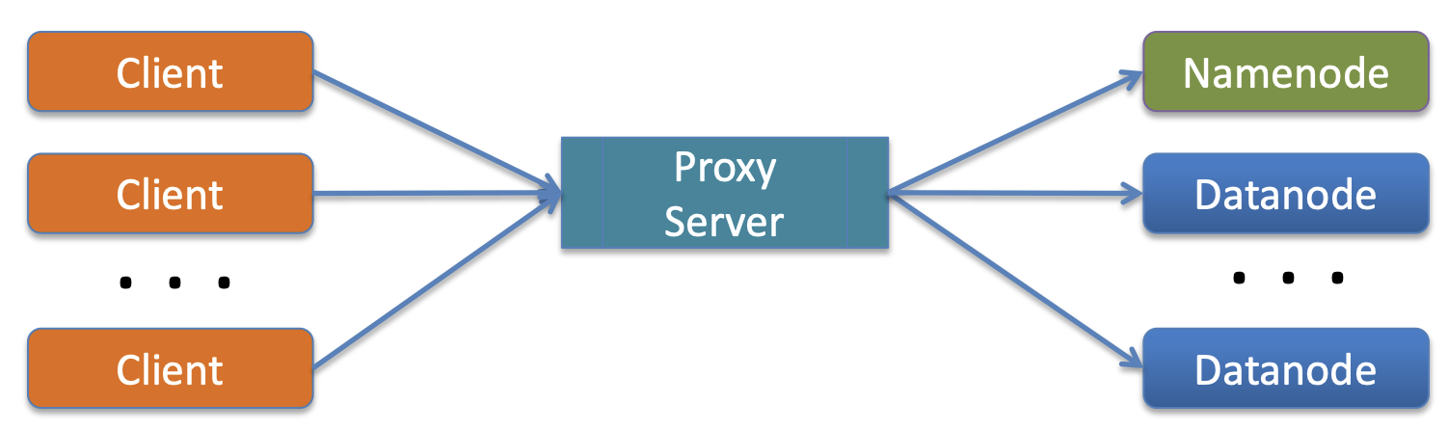
HDFS access — Proxy Server
Client works through an external Proxy Server
Several servers are included with Hadoop:
Thrift – interface definition language
WebHDFS REST – responses in JSON, XML, or ProtoBuf
Avro – serialization framework
Python bindings: !pip install hdfs

Slide 51
Key features
Large block size
Designed for inexpensive, and therefore not the most reliable, servers
Cluster-level replication
Replication occurs asynchronously
Clients can read and write HDFS files directly via the Java API
Files are written once
WORM principle (Write-once, read-many)
Data compression and efficient use of disk space
Self-diagnosis
All NameNode metadata is stored in RAM

Slide 52
HDFS vs S3
Criterion | HDFS | S3
Architecture | Filesystem, NameNode + DataNode | Object storage
Data locality | Data locality for MapReduce/Spark | No data locality, compute is separate
Scaling | Limited by NameNode metadata | Practically unlimited
Cost | Requires its own clusters | Pay for storage and requests
Speed | Low latency inside the cluster | Higher latency, depends on the network

Slide 53
HDFS Shell

Slide 54
HDFS Shell
Basic command structure:
$hdfs dfs -<command> -<option> <URI>
Ex.: $hdfs dfs –ls /

Slide 55
HDFS Shell. URI
hdfs://namenode:9000/user/home
Scheme Authority HDFS path
• Local:
$hdfs dfs -ls file:///to/path/file3
• HDFS:
$hdfs dfs -ls hdfs://localhost/to/path/dir
• fs.default.name=hdfs://localhost
$hdfs dfs -ls /to/path/dir

Slide 56
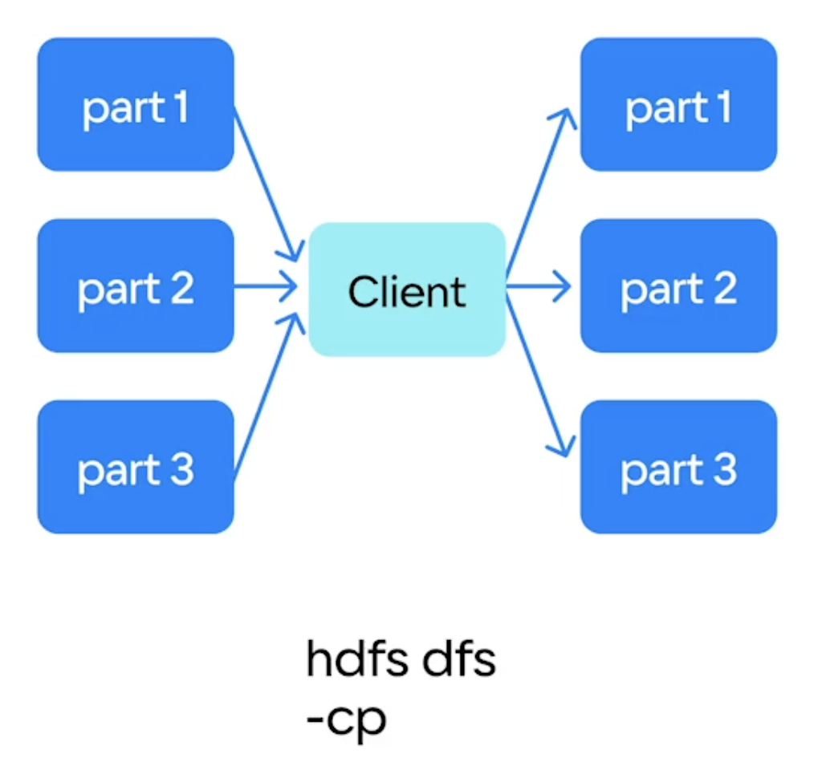
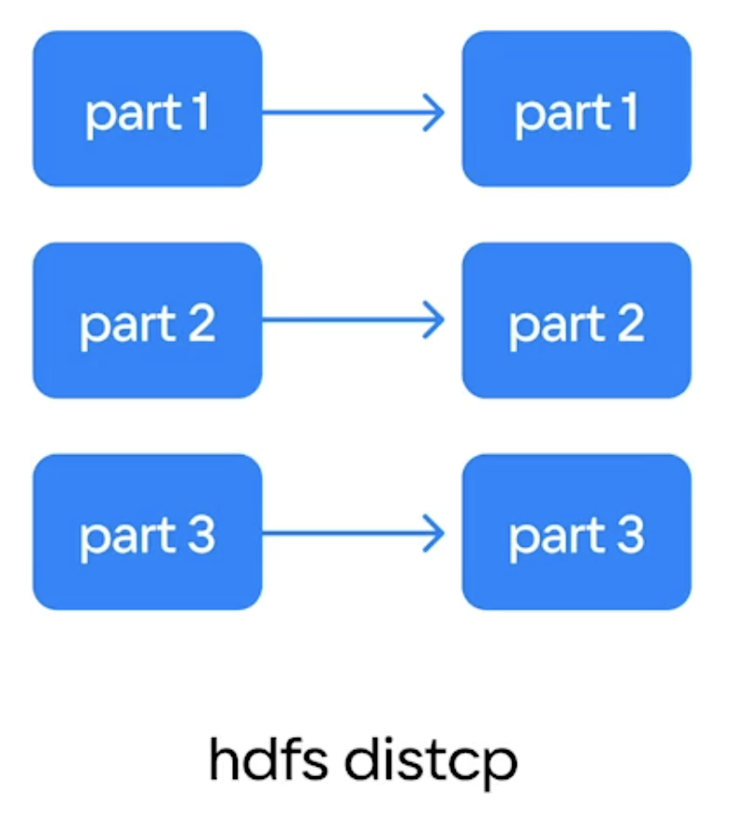
HDFS Shell. Commands
Bash-like commands:
cat, rm, ls, du, mkdir, cat, tail, …
Specific commands:
setrep — to set replication factor:
hdfs dfs -setrep <rep_factor> <path>
help — get reference:
hdfs dfs -help
hdfs dfs -help <command_name>
text — like cat but uncompress archives
cp — to copy small files
distcp — to copy large files or many files

Slide 57
HDFS Shell. Data transfer
mv – move a file from one place to another:
hdfs dfs -mv /dir/file1 /dir2
put (copyFromLocal) – copy a local file into HDFS:
hdfs dfs -put localfile /dir/file
get (copyToLocal) – copy a file from HDFS into the local FS:
hdfs dfs -get /dir/file localfile

Slide 58
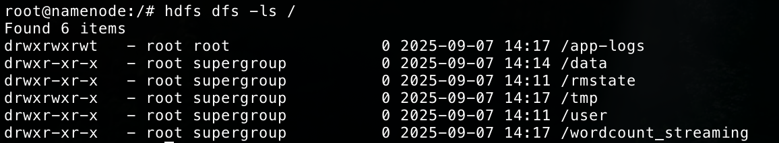
HDFS Shell. Permissions in HDFS
Restrictions at the file/directory level – Similar to the POSIX permission model – Read (r), Write (w), and Execute (x) – Divided into: user, group, and others
User rights are determined based on the rights of the OS where the client application is running
Authorization is performed via Kerberos

Slide 59
HDFS Shell. fsck
Checks the filesystem for inconsistencies
Shows issues such as:
Missing blocks
Under-replicated blocks
Does not fix problems, only reports them
NameNode will try to repair issues automatically
Examples:
Check a specific path $hdfs fsck <path>
Check the entire filesystem $hdfs fsck /

Slide 60
HDFS Shell. dfsadmin
Commands for HDFS administration – $hdfs dfsadmin -<command> – Example: $hdfs dfsadmin -report
report – displays HDFS statistics
safemode – enables safe mode for administrative tasks – Used for upgrade, backup, etc.

Slide 61
HDFS Shell. fsimage, edits & EC
Get a current state of the FC:
$hdfs dfsadmin -fetchImage /tmp/fsimage
Convert it to the readable xml format:
$hdfs oiv -i fsimage -o xml -p Delimited
Manage EC policies for different directories:
$hdfs ec –listPolicies
$hdfs ec -setPolicy -path <dir_path> -policy <policy>

Slide 62
HDFS Shell. Balancer
Blocks in HDFS may be unevenly distributed across the cluster’s DataNodes
Balancer – a utility that automatically analyzes block placement in HDFS and attempts to rebalance them
Command: $hdfs balancer

Slide 63
HDFS Shell. Snapshots
Allow creating a point-in-time copy of a directory without duplicating data (copy-on-write)
Useful for protecting against accidental file deletion/modification
Create: hdfs dfs -createSnapshot /dir snap1
Delete: hdfs dfs -deleteSnapshot /dir snap1
List: hdfs dfs -listSnapshots /dir

